Slide 1
The queue data structure is a sequential collection of elements that follows the principle of first in first out(FIFO)
The first element into the queue is the first element to be removed.
A queue of people. People enter the queue at one end(rear/tail) and leave the queue from the other end ( front/end).
Queue is an abstract data type. It is defined by the its behaviors rather tan being a mathematical model.
The Queue data structure supports two main operations
Enqueue, which adds an element to the rear/tail of the collection
Dequeue, which removes an element from the front/end of the collection
The queue usage
Printer, CPU task scheduling, callback in JavaScript runtime

Slide 2
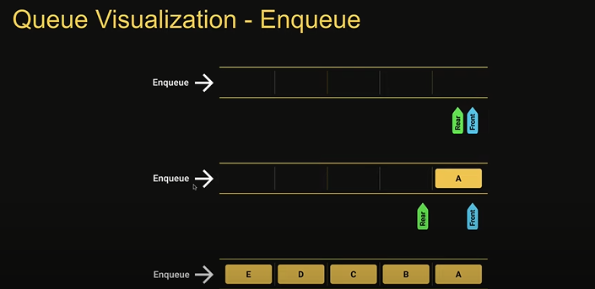
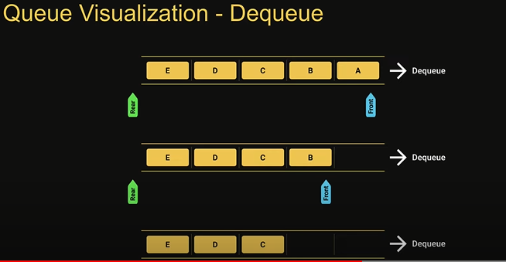
Queue Implementation
Enqueue (element) =- add an element to the queue
Dequeue () – remove the oldest element from the queue
Peek()- get the value of the element at the front of the quque without removing it
isEmpty() - check if the queue is empty
Size() – get the number of elements in the queue
Print() – visualize the elements in the queue

